Slide 1
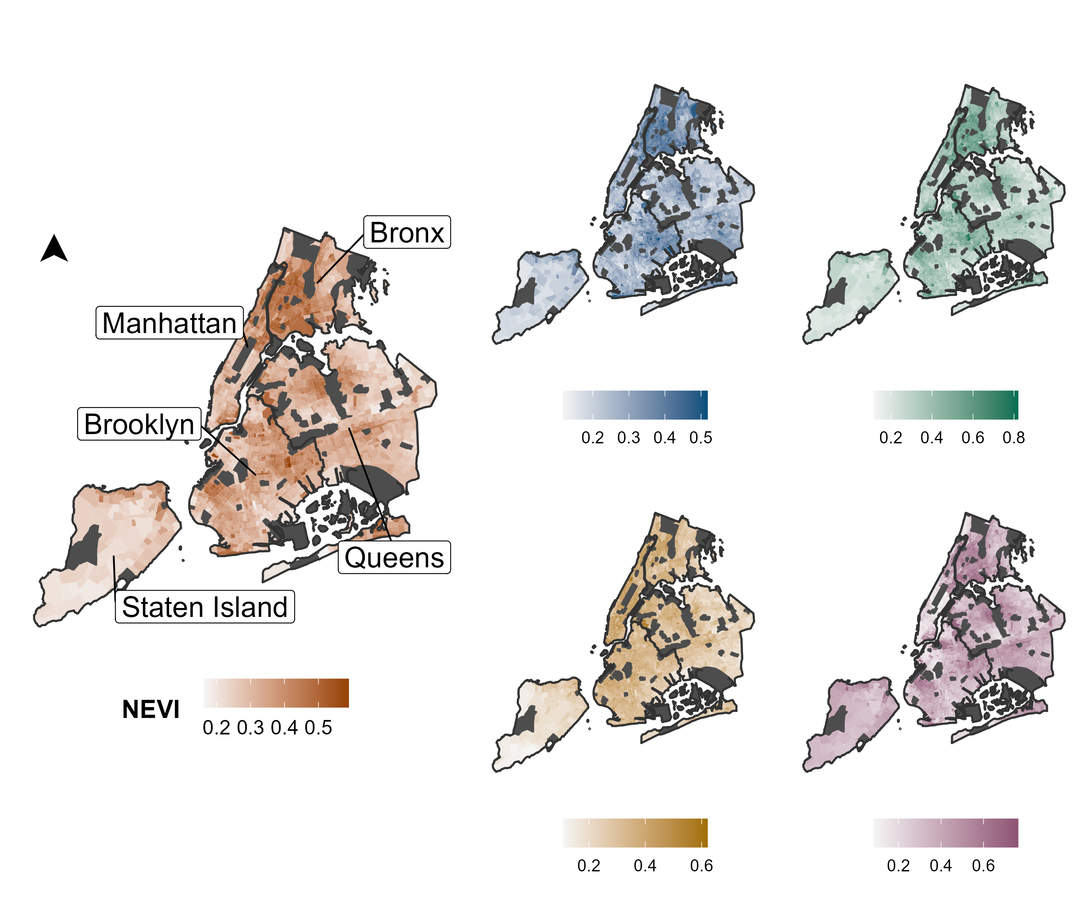
NEVI Domain Scores
Economic Indicators
Demographics
Domain Score
Domain Score
Residential Characteristics
Health Status
Domain Score
Domain Score

